Slide 1
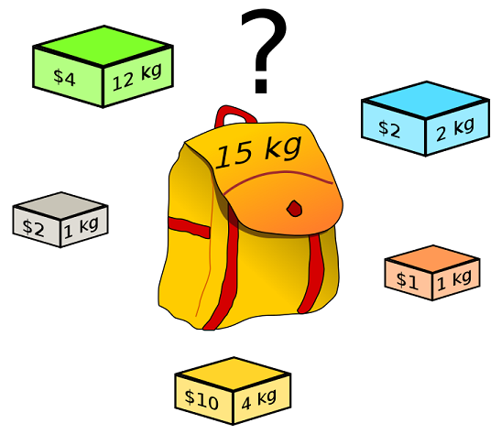
0-1 Knapsack Problem
Consider a knapsack that can tolerate total weight W
Each item has a value and a weight
Problem: how to maximize the total value of the items while total weight ≤W

Slide 2
Formal 0-1 Knapsack Problem
S = {item₁, item₂,…, item_{n}}
w_{i}: weight of item_{i}
v_{i}: value of item_{i}
W: maximum weight the knapsack can hold
We have one instance from each item (no duplicates)
Goal: Choose subset of items with maximum total value when:

Slide 3
Solutions for 0-1 Knapsack Problem
Brute-force
Try all possible solutions and pick the optimal one.
What is the complexity?
There is an optimal solution for the problem using Dynamic Programming
O(2^{n})

Slide 4
Principle of Optimality for 0-1 Knapsack Problem
An optimal solution for a problem includes optimal solutions for all sub-problems
Suppose A is the optimal subset
For item_{n} we can consider two cases:
item_{n} is not in A
Then A is an optimal subset with n-1 items
item_{n} is in A
Then the rest of n-1 elements should be optimal
Therefore, the principle of optimality holds!

Slide 5
Knapsack Optimal Structure
M[n , w]= Subset of n items with maximum value and total weight w
If item i included then M[i , w]= v_{i} +M[i-1 , w-w _{i} ]
If item i not included then M[i , w]= M[i-1 , w]
If w_{i} > W (item i not included) then M[i , w]= M[i-1, w]
M[i , w]:

Slide 6
Knapsack Optimal Structure with Recursive Formula
item_{i} is selected
item_{i} is not selected
M[i ,w]= max{ (v_{i} +M[i-1 , w-w_{i}]), M[i-1,w]}
If w_{i} > w (item_{i} not included) then M[i , w]= M[i-1,w]
M[0,w]=0
M[i,0]=0
M[i , w] :

Slide 7
DP solution for Knapsack: Top-Down approach
arr[n+1][w+1]
M[n , w]{
if (n==0 or w==0) return 0;
if (w_{n}>W) return M[n-1 , w];
else
result= max{ (v_{n} +M[n-1 , W-w_{n}]), M[n-1 , w]};
return result;}
if arr[n,w]!=0 return arr[n,w];
arr[n,w] = result;
Include item n
Not include item n
Grows exponentially! How DP can be applied?
time complexity: O(n*W)

Slide 8
DP solution for Knapsack: Bottom-Up approach
j(capacity)
M[n , w]{
if (n==0 or w==0) return 0;
for (i=0 ; i++ ; i<=n) M[i,0]=0;
for (j=0 ; j++ ; j<=w) M[0,j]=0;
for (i=1 ; i++ ; i<=n)
for (j=1 ; j++ ; j<=w)
if (w_{i} >j) M[i,j]= M[i-1, j];
else M[i,j]= max{ (v_{i} +M[i-1 , j-w_{i}]), M[i-1 , j] };
}
i(items)
w
 | 0 | 1 | . . . | w
0 | 0 | 0 | 0 | 0
1 | 0
2 | 0
. . . | 0
n | 0 |  |  | max M[n,w]
n
// i not selected
The value of the previous items when limit was j-w_{i}
space complexity: O(nW)

